Slide 1
Class Demographic
A Team Four Presentation
Created by: Giselle Larcombe (A00693783) Jean-Philippe Aubin (A00683569) Sean Earhard (A00024208) Chi Turner (A00027941)

Slide 2
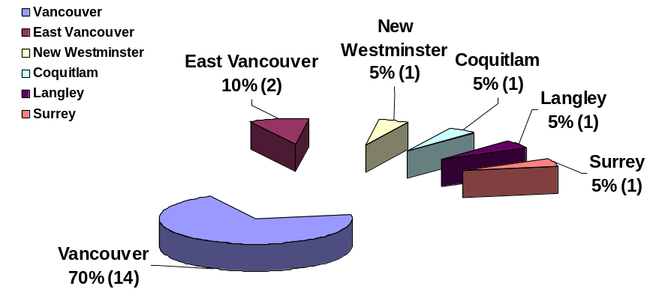
City You Live In

Slide 3
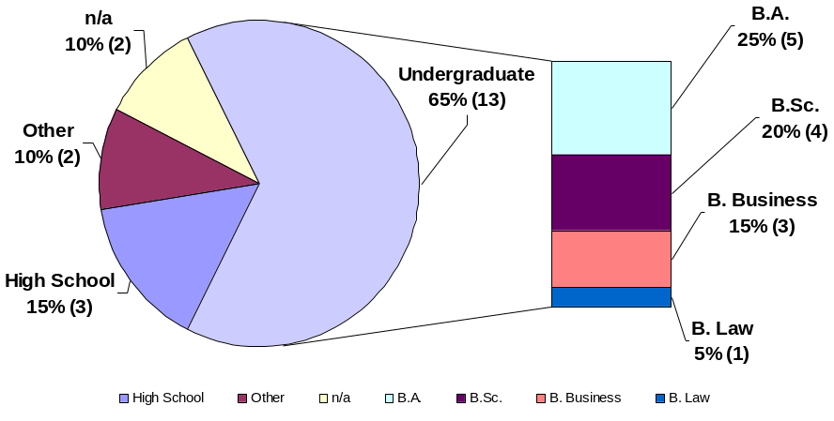
Educational Background (Last Graduation)

Slide 4
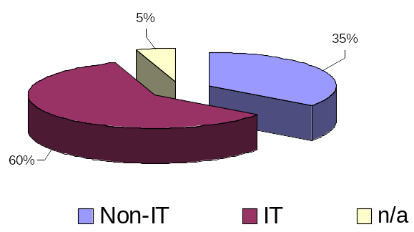
Type Of Work

Slide 5
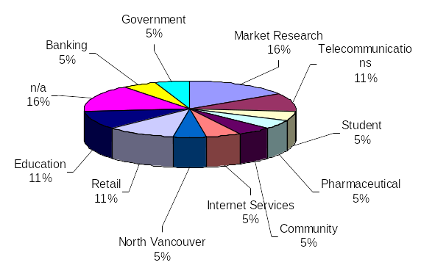
Industry

Slide 6
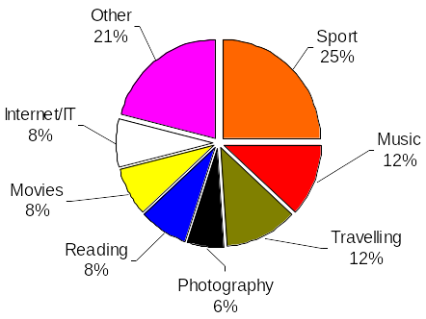
Hobbies / Special Interests

Slide 7
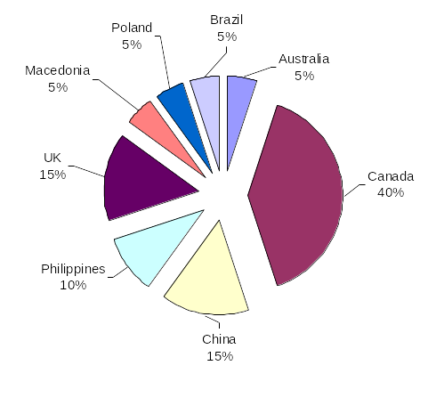
Where You Were Born

Slide 8
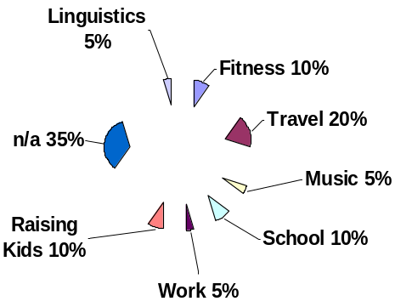
Major Achievements

Slide 9
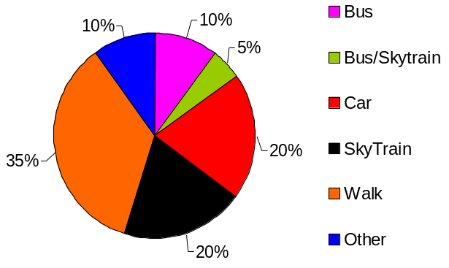
Commute to BCIT
* Other = Walk and Bus during Winter, Bus if healthy, walk if lazy

Slide 10
End of Presentation
Presented 04/19/2007

